Slide 1
PerfTest: Setup (WSAS)
Yoonki Song
Last Updated: Sep. 16, 2009

Slide 2
Outline
Download Packages from IBM Academic Initiative
WebSphere Application Server (WSAS) v6.1
Rational Performance Tester (RPT) v8.0
Install Packages on the Server side
WSAS v6.1
RPT Agent (with DCI) v8.0
Install Packages on the Client side
RPT (with Agent) v8.0

Slide 3
IBM Academic Initiative
Query: “WebSphere Application Server v6.1”
WebSphere Application Server V6.1 for Linux on x86Series Multilingual eAssembly (CR3ADML)
Part: WebSphere Application Server V6.1 for Linux on x86Series, 32-bit Support (C87QXML)
Part: WebSphere Application Server V6.1 Supplements Application Client, IBM HTTP Server, Web Server Plug-ins, Installation Factory, Migration Tool, IBM Support Assistant and Update Installer for Linux on x86Series, 32-bit Support Multilingual (C87PSML)
Part Information (in detail)
http://www-01.ibm.com/support/docview.wss?rs=180&uid=swg27007743

Slide 4
IBM Academic Initiative (Cont’d)
Query: “Rational Performance Tester V8.0”
IBM Rational Performance Tester V8.0 Multiplatform Multilingual eAssembly (Core) (CR7VNML) <- RPT Agent (Link Error?)
IBM Rational Performance Tester V8.0 for z/OS Multiplatform Multilingual eAssembly (Core) (CR7XFML) <- RPT (Link Error?)
Part Information (in detail)
http://www-01.ibm.com/support/docview.wss?rs=180&uid=swg27007743

Slide 5
WebSphere Application Server v6.1
Installation and Configuration on the Server side

Slide 6
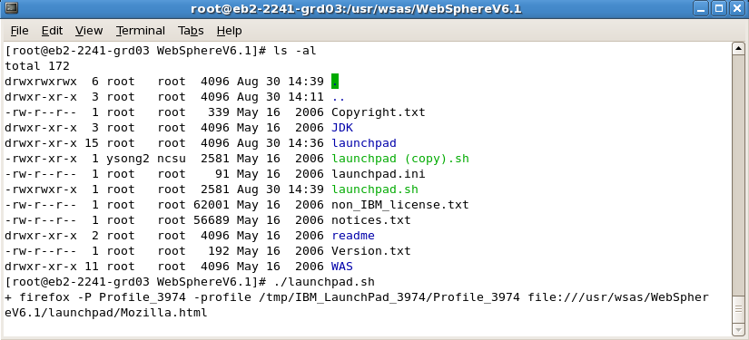
WSAS Installation
# ./launchpad.sh

Slide 7
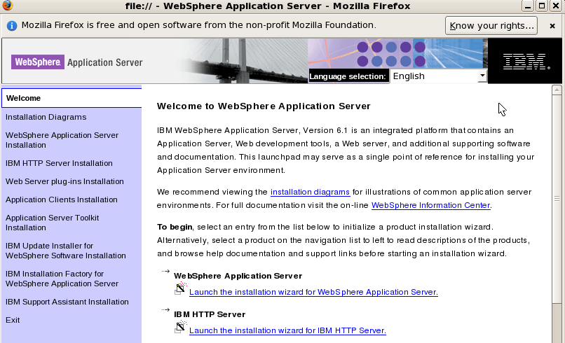
WSAS Installation (Cont’d)
Launch the installation wizard for WebSphere Application Server

Slide 8
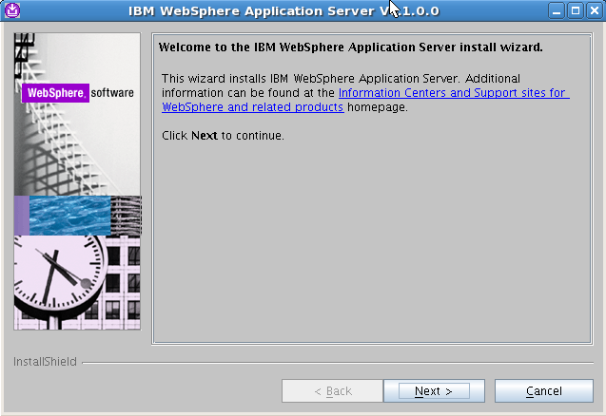
WSAS Installation (Cont’d)

Slide 9
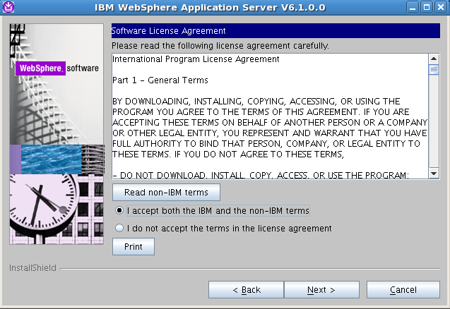
WSAS Installation (Cont’d)

Slide 10
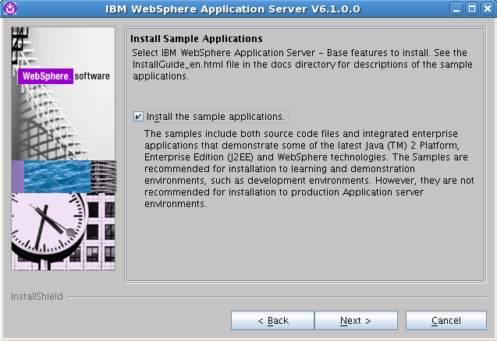
WSAS Installation (Cont’d)

Slide 11
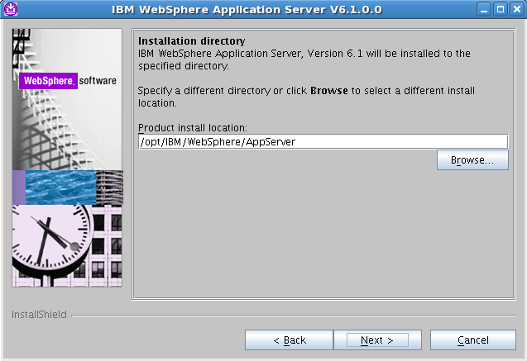
WSAS Installation (Cont’d)

Slide 12
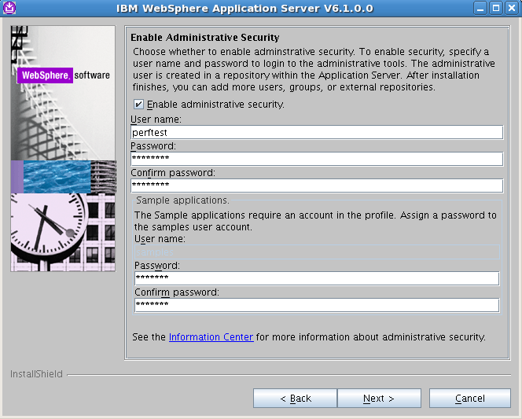
WSAS Installation (Cont’d)
perftest
perftest
perftest
samples
samples
samples

Slide 13
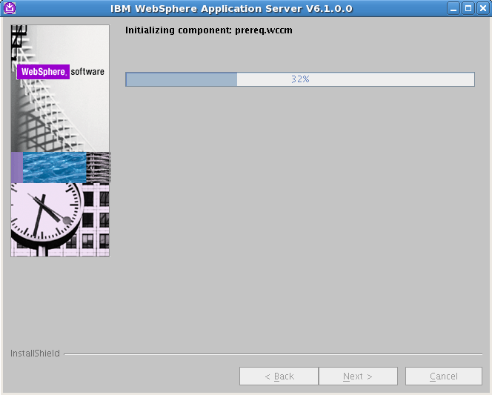
WSAS Installation (Cont’d)

Slide 14
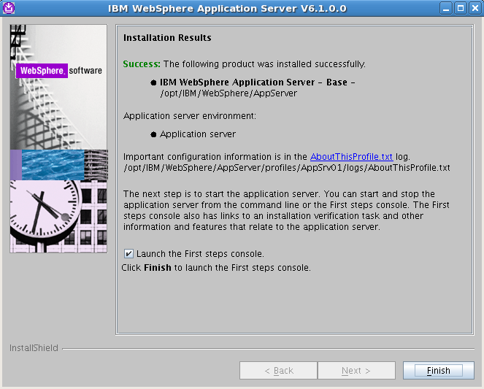
WSAS Installation (Cont’d)

Slide 15
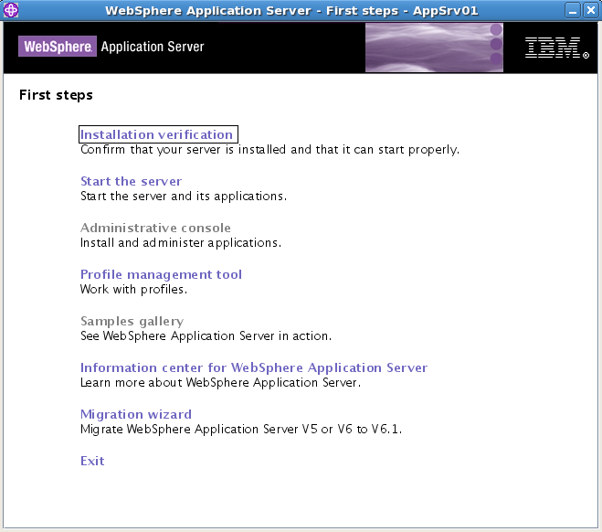
Installation Verification

Slide 16
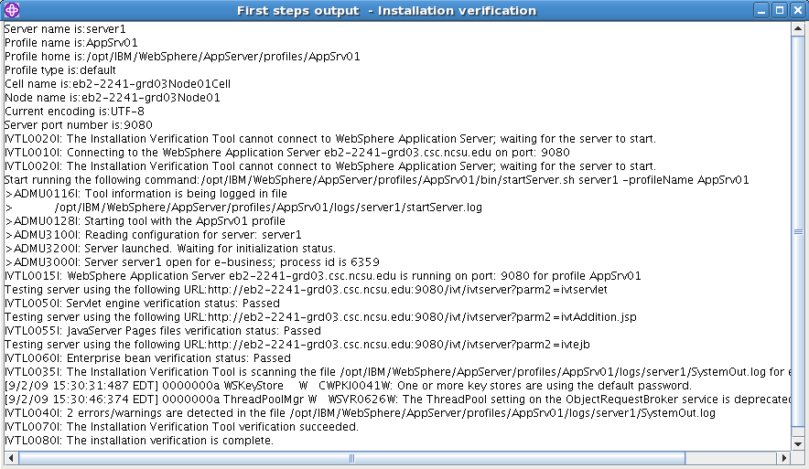
Installation Verification (Cont’d)

Slide 17
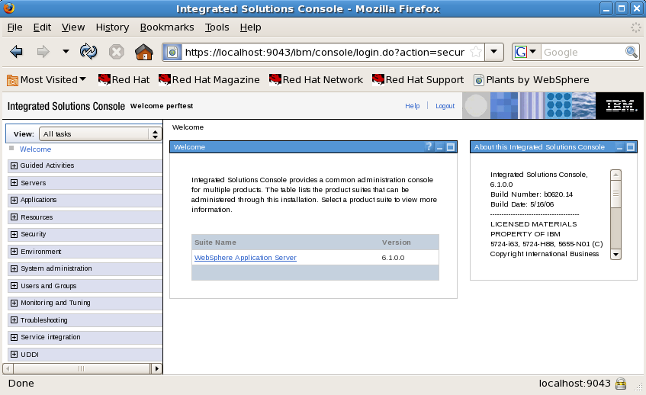
Administrative Console

Slide 18
Uninstallation (Optional)
Uninstall
/opt/IBM/WebSphere/AppServer/uninstall/uninstall -silent

Slide 19
IBM WebSphere Application Server commands
Start the IBM WebSphere Application server
/opt/IBM/WebSphere/AppServer/bin/startServer.sh server1
Stop the IBM WebSphere Application server
/opt/IBM/WebSphere/AppServer/bin/stopServer.sh server1
Check status of the IBM WebSphere Application Server
/opt/IBM/WebSphere/AppServer/bin/serverStatus.sh server1
Regenerate the Web server plug-in config file (which connects WAS to the Web Server)
/opt/IBM/WebSphere/AppServer/bin/GenPluginCfg.sh
Use the IBM WebSphere command line administration tool
/opt/IBM/WebSphere/AppServer/bin/wsadmin.sh

Slide 20
Using WSAS Administrative Console
Check the status of the application server:
/opt/IBM/WebSphere/AppServer/bin/serverStatus.sh server1
If the status replies that the Application server “server1” is not started:
/opt/IBM/WebSphere/AppServer/bin/startServer.sh server1
Start Firefox in the background:
firefox &
To open the administrative console, enter the URL:
http://localhost:9090/admin

Slide 21
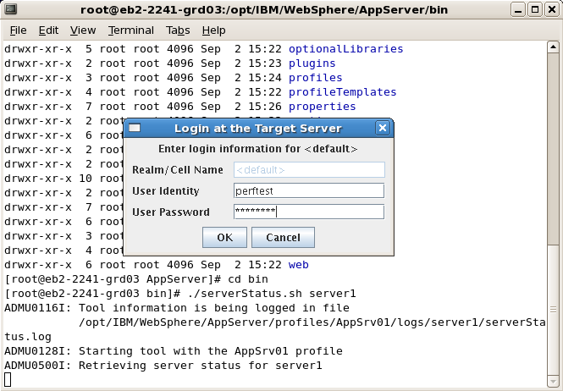
Starting WSAS
perftest
perftest

Slide 22
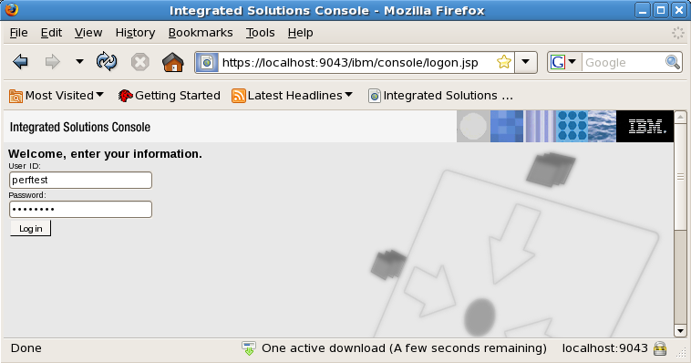
Starting WSAS
perftest
perftest

Slide 23
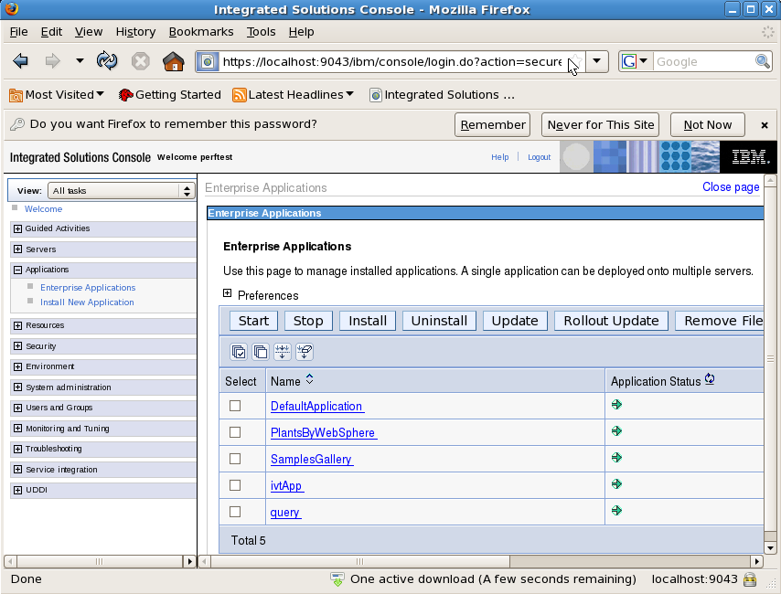
Starting WSAS
[Source Code] /opt/IBM/WebSphere/AppServer/samples/src/PlantsByWebSphere

Slide 24
Starting WSAS
Start the AC on the server
/opt/IBM/SDP/AgentController/bin/ACStart.sh
…

Slide 25
Trouble Shooting
ADMU3011E: Server fails to start on Linux platforms
http://www-01.ibm.com/support/docview.wss?uid=swg21287231
JVMJ9VM011W: Unable to load piAgent
http://www-01.ibm.com/support/docview.wss?uid=swg21288832 (Bad)
http://www-01.ibm.com/support/docview.wss?rs=180&uid=swg21246403 (Bad)

Slide 26
Export LD_LIBRARY_PATH
export
LD_LIBRARY_PATH=/usr/local/lib:${LD_LIBRARY_PATH}
To permanently set it for all users.
$ su -
Password:
# cd
/etc/ld.so.conf.d
# echo /usr/local/lib >local.conf
# exit

Slide 27
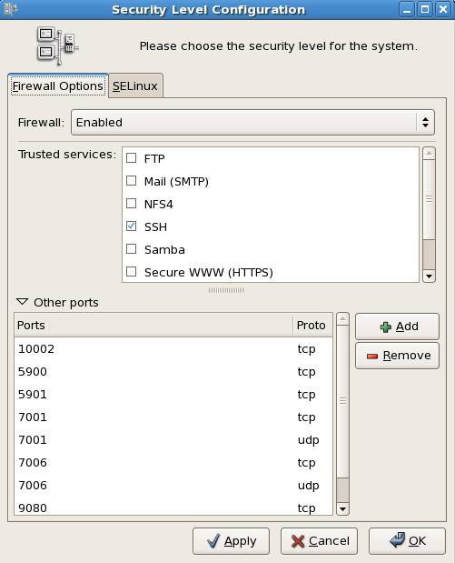
Ports should be opened
9080
system-config-securitylevel

Slide 28
Agent Controller
Installation and Configuration on the Server side

Slide 29
Repository
/usr/rptagent
Installation Directory
/opt/IBM/SDP/AgentController
Starting AC
# /opt/IBM/SDP/AgentController/bin/ACStart.sh

Slide 30
Rational Performance Tester v8.0
Installation and Configuration on the Client side

Slide 31
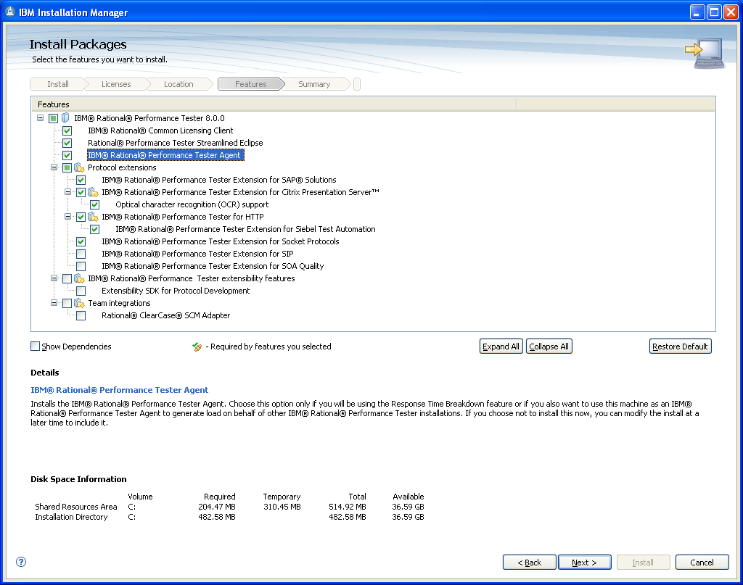
RPT Installation

Slide 32
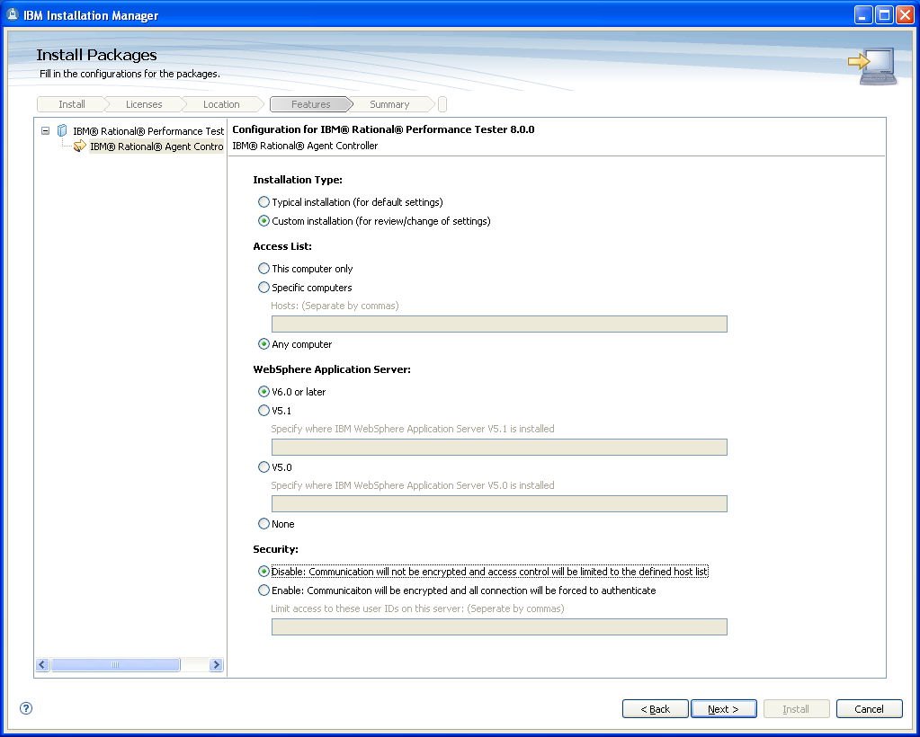
RPT Installation (Cont’d)

Slide 33
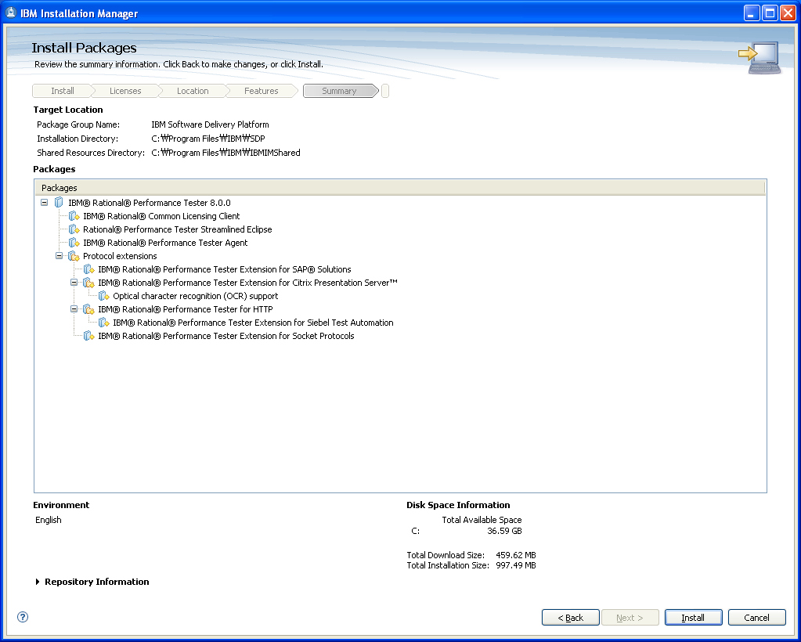
RPT Installation (Cont’d)

Slide 34
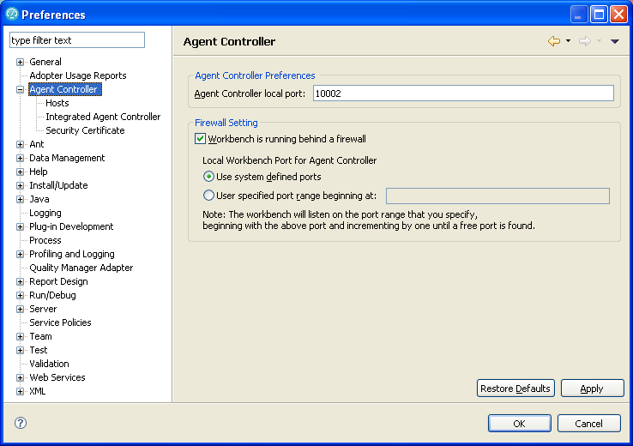
RPT Configuration

Slide 35
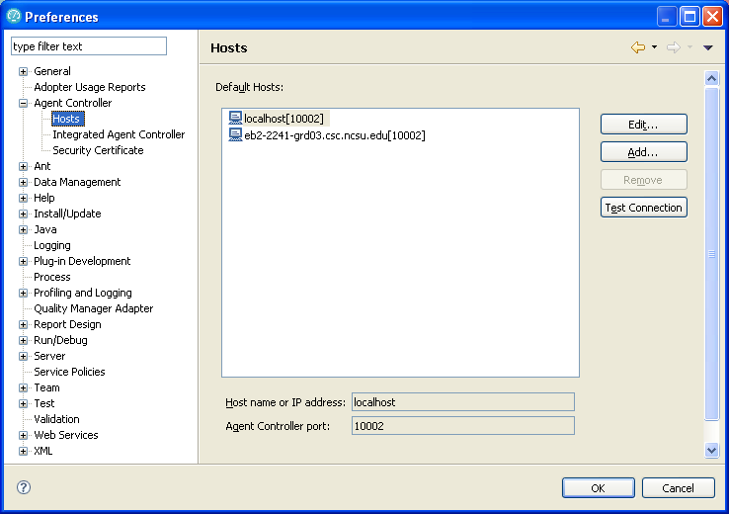
RPT Configuration (Cont’d)

Slide 36
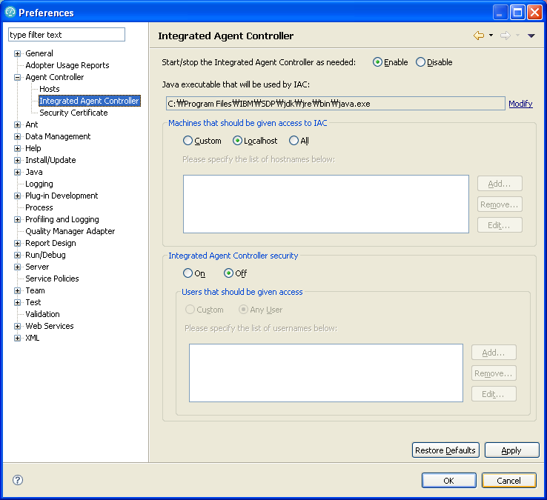
RPT Configuration (Cont’d)

Slide 37
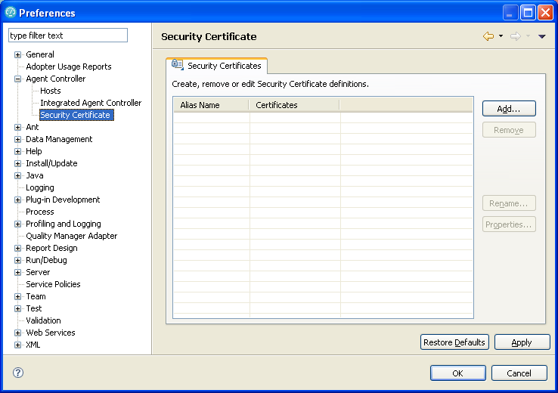
RPT Configuration (Cont’d)

Slide 38
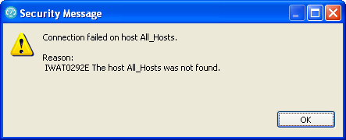
Trouble Shooting
IWAT0292E
http://www.ibm.com/developerworks/forums/message.jspa?messageID=13938063

Slide 39
VNC
Installation and Configuration

Slide 40
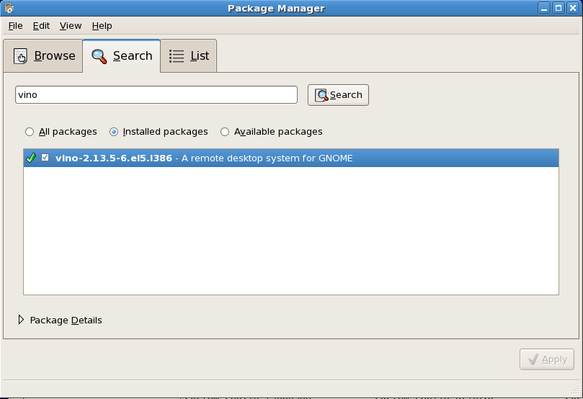
Set up VNC Server
[Applications] –[Add/Remove Software] or #pirut
Check out whether “vino” is installed

Slide 41
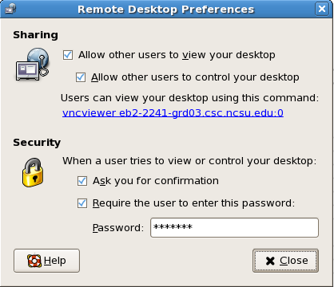
Set up VNC Server (Cont’d)
[System]-[Preferences]-[Remote Desktop]

Slide 42
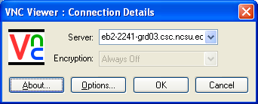
Connect to eb2-2241-grd03
eb2-2241-grd03.csc.ncsu.edu:0
Start vncserver
#service vncserver start
Register
…

Slide 43
Setting up the server
/etc/sysconfig/vncservers

Slide 44
References
http://kin.naver.com/detail/detail.php?d1id=1&dir_id=10202&docid=7848413&qb=dm5jc2VydmVy&enc=utf8

